Slide 1
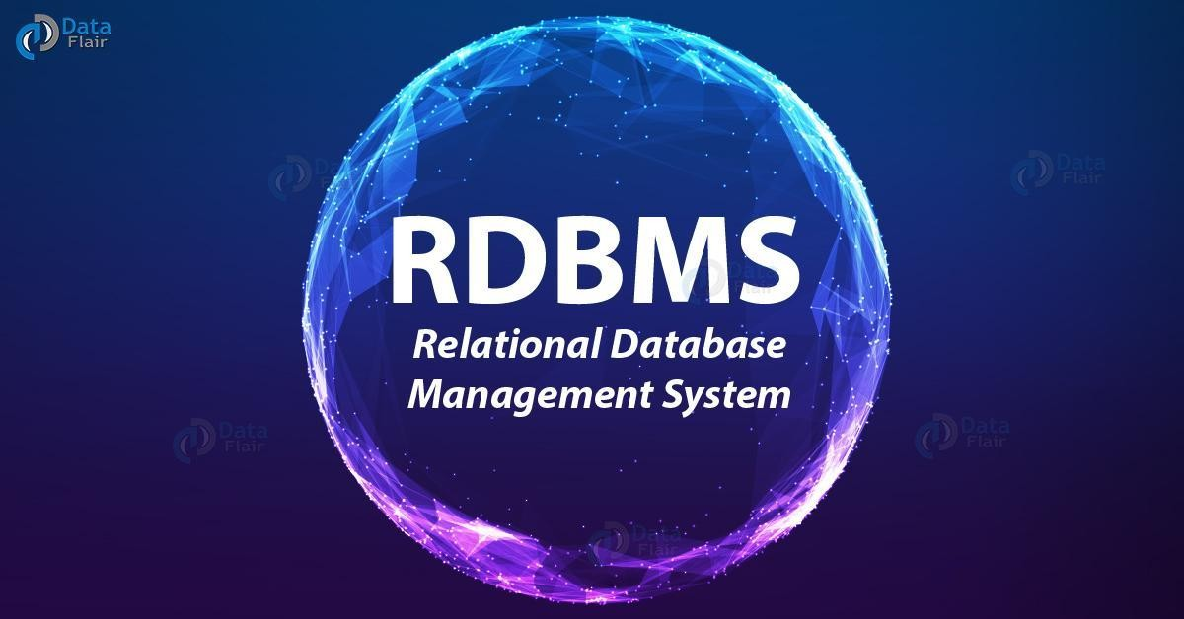

Slide 2
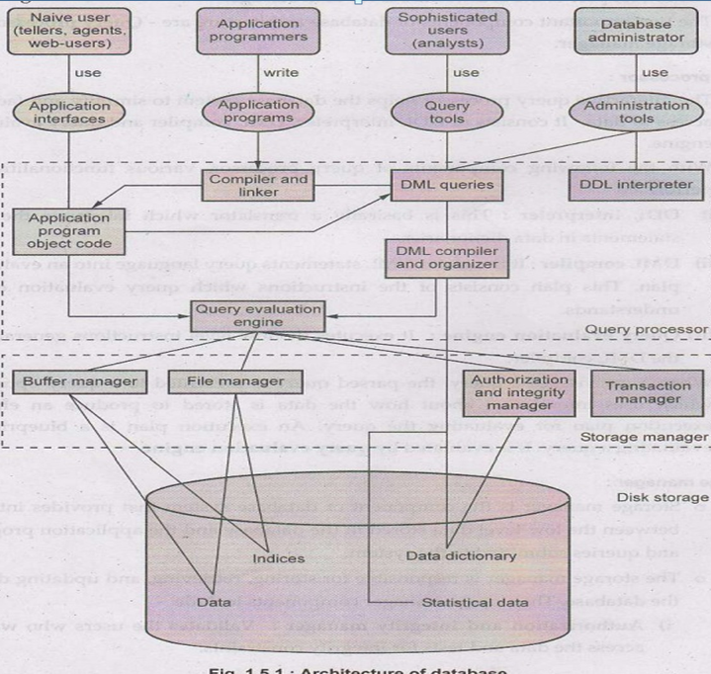

Slide 3
It shows application interfaces used by naïve users, application programs created by application programmers, query tools used by sophisticated users and administration tools used by database administrator.
• The lowest part of the architecture is for disk storage.
• The two important components of database architecture are - Query processor and storage manager.
Query processor:The interactive query processor helps the database system to simplify and facilitate access to data. It consists of DDL interpreter, DML compiler and query evaluation engine.
• With the following components of query processor, various functionalities are performed -
i) DDL interpreter: This is basically a translator which interprets the DDL statements in data dictionaries.
ii) DML compiler: It translates DML statements query language into an evaluation plan. This plan consists of the instructions which query evaluation engine understands.

Slide 4
Query evaluation engine: It executes the low-level instructions generated by the DML compiler.
• When a user issues a query, the parsed query is presented to a query optimizer, which uses information about how the data is stored to produce an efficient execution plan for evaluating the query. An execution plan is a blueprint for evaluating a query. It is evaluated by query evaluation engine.
Storage manager:
• Storage manager is the component of database system that provides interface between the low level data stored in the database and the application programs and queries submitted to the system.
• The storage manager is responsible for storing, retrieving, and updating datain the database. The storage manager components include -

Slide 5
i) Authorization and integrity manager: Validates the users who want to access the data and tests for integrity constraints.
ii) Transaction manager: Ensures that the database remains in consistent despite of system failures and concurrent transaction execution proceeds without conflicting.
iii) File manager: Manages allocation of space on disk storage and representation of the information on disk.
iv) Buffer manager: Manages the fetching of data from disk storage into main memory. The buffer manager also decides what data to cache in main memory. Buffer manager is a crucial part of database system.
• Storage manager implements several data structures such as -
i) Data files: Used for storing database itself.
ii) Data dictionary: Used for storing metadata, particularly schema of database.
iii) Indices: Indices are used to provide fast access to data items present in the database

